Slide 1
LMI Data Synthesis Competition
The Warriors Team
Sheng Luo, Xiaochi (George) Li, Xinyu (Mandy) Zhang
The George Washington University

Slide 2
Outline
Exploratory Data Analysis (EDA)
Data Preprocessing
Autoencoder Data Synthesis
Model building
Linear Regression
XGBoost
Autoencoder
Final Output

Slide 3
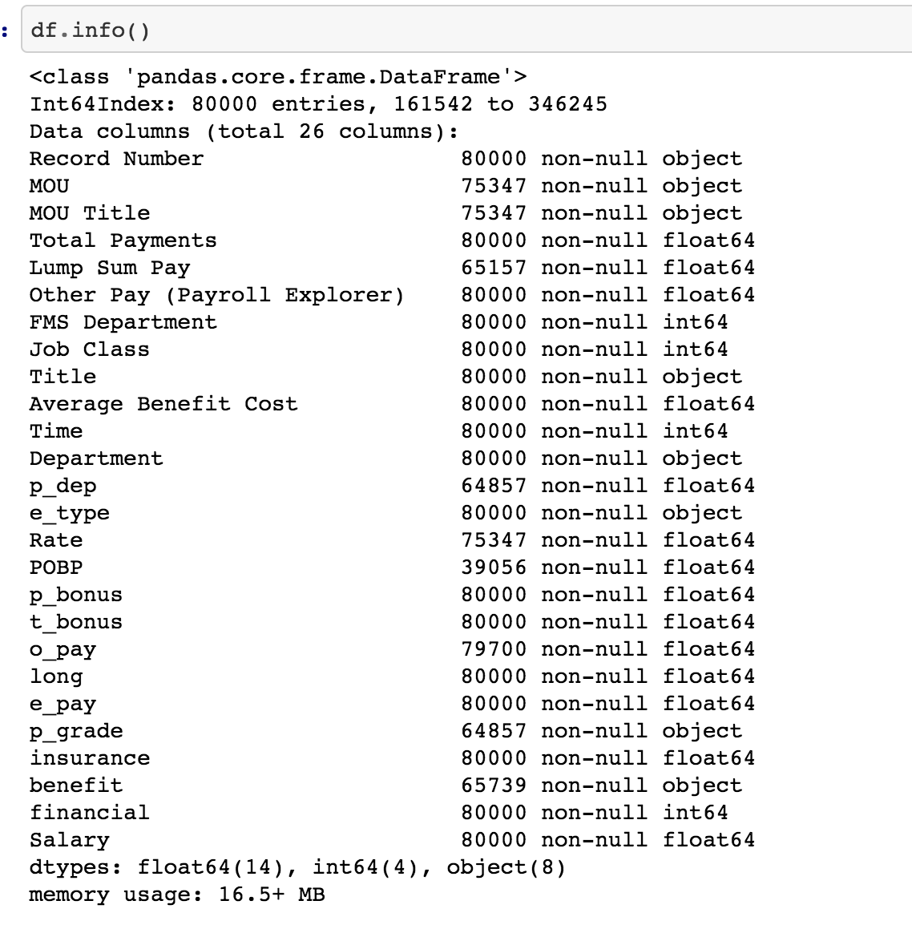
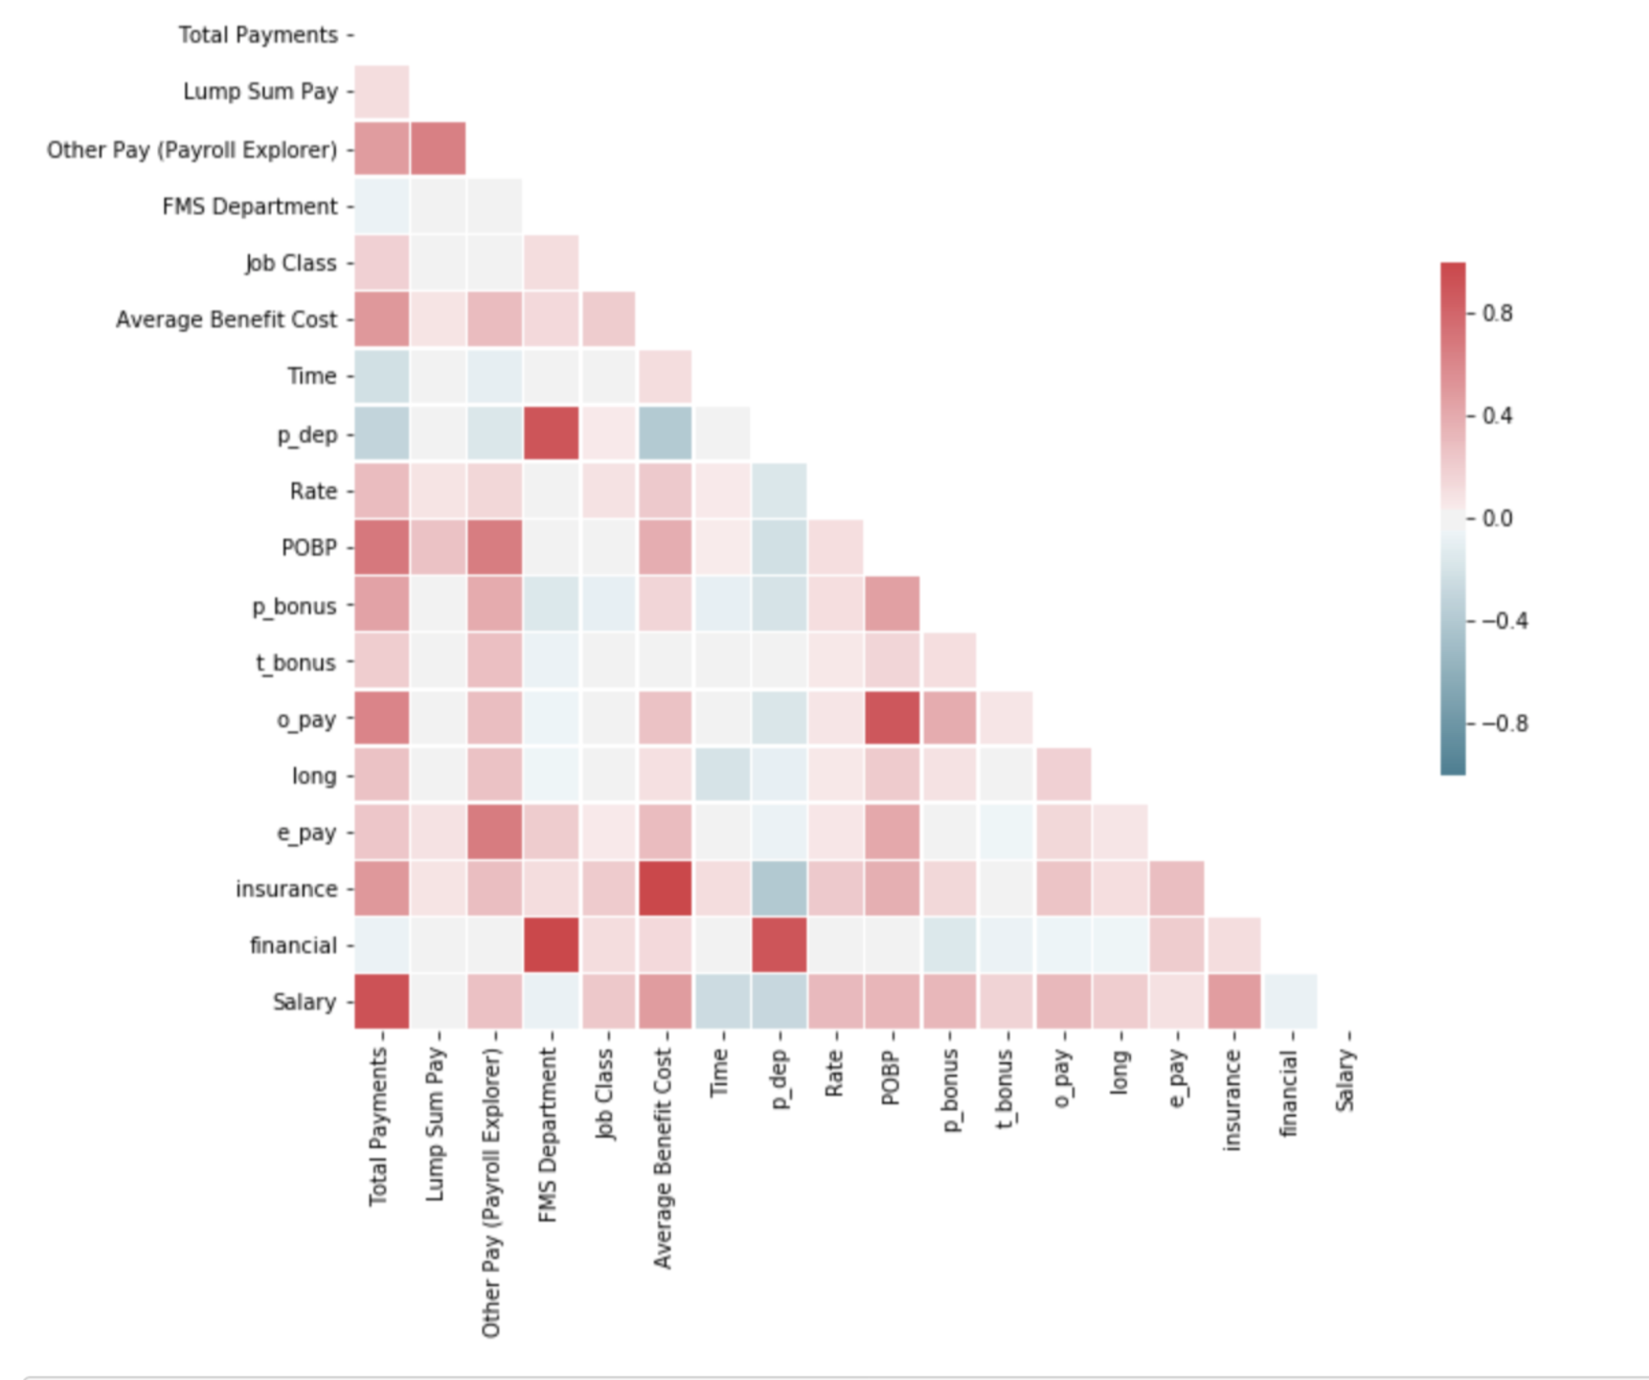
Exploratory Data Analysis

Slide 4
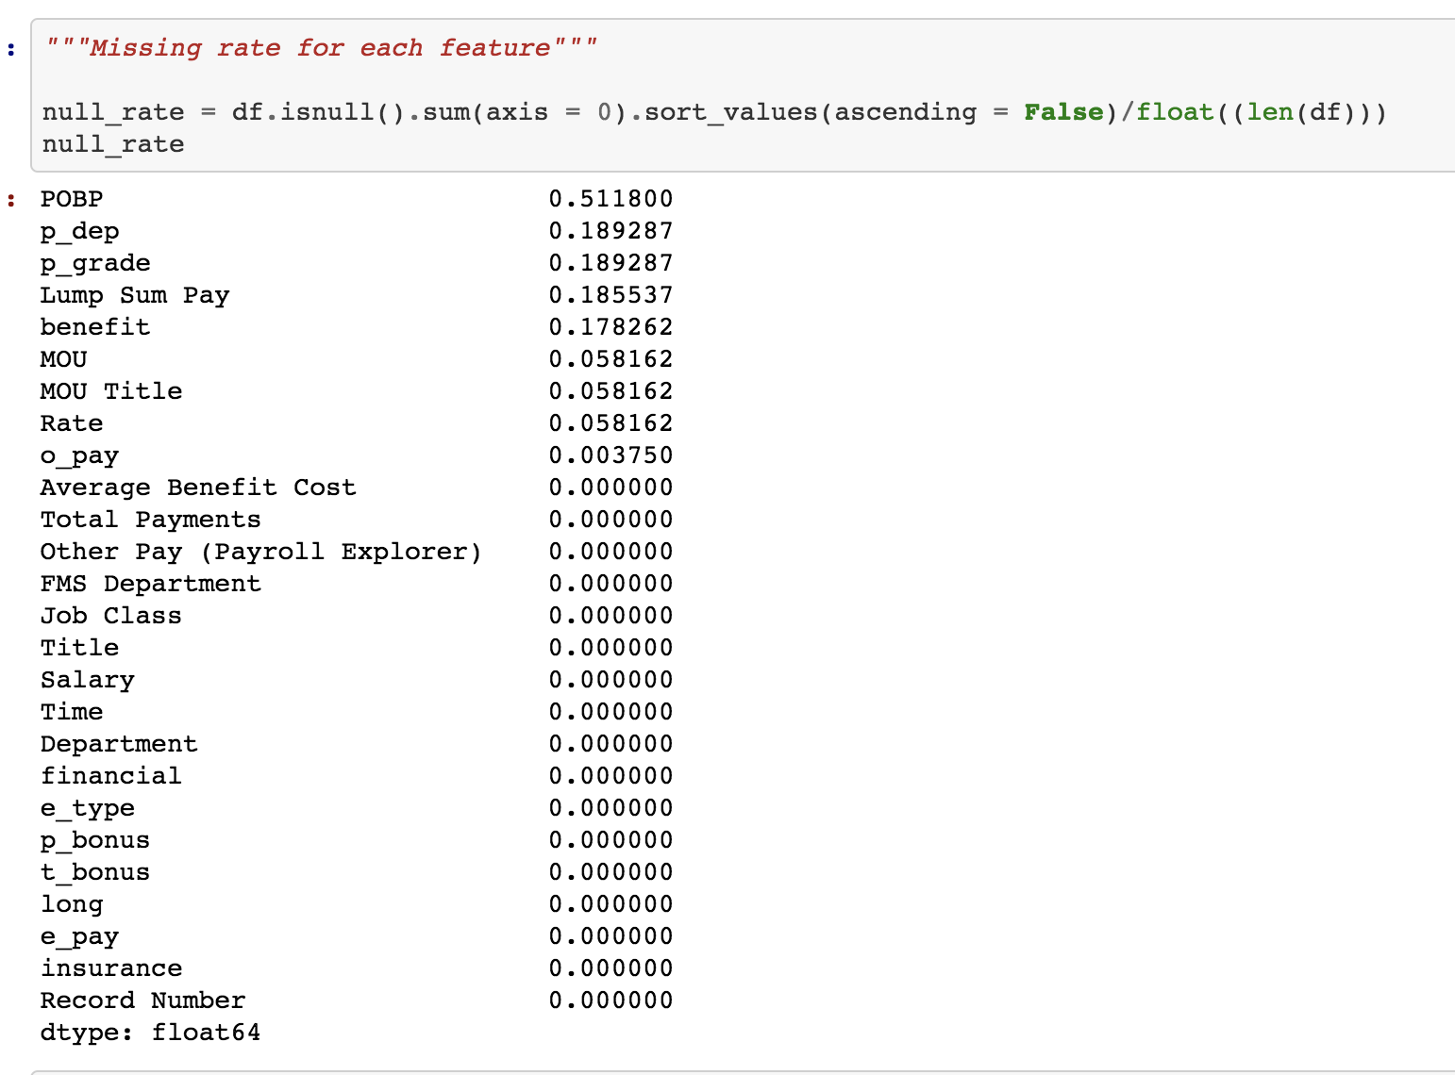
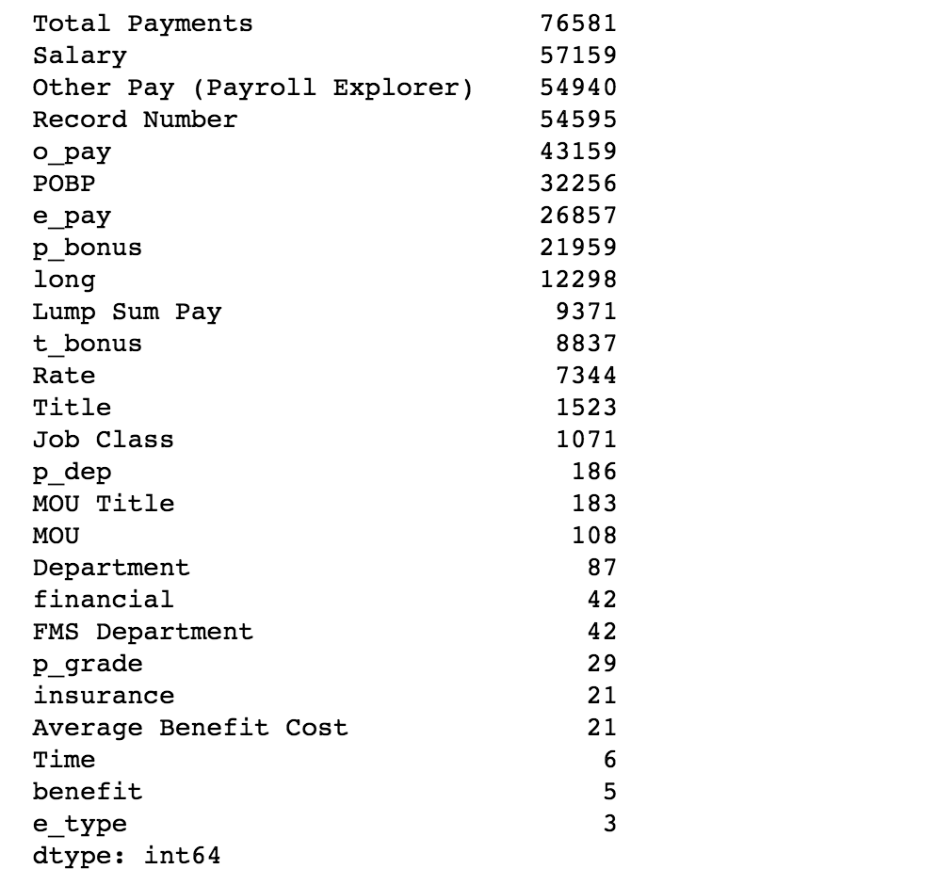
Missing rate for each feature/column
Unique rate for each feature

Slide 5
Data Preprocessing
Remove unnecessary features:
MOU
MOU Title
Title
Department
Record Number
POBP (>50% missing)
Simple data imputation:
P_dep: mean
Rate: mean
O_pay: median
Benefit: impute as “-1”
P_grade: impute as “-1”
Lum sum pay: impute as “0”
Save preprocessed data to pickle file

Slide 6
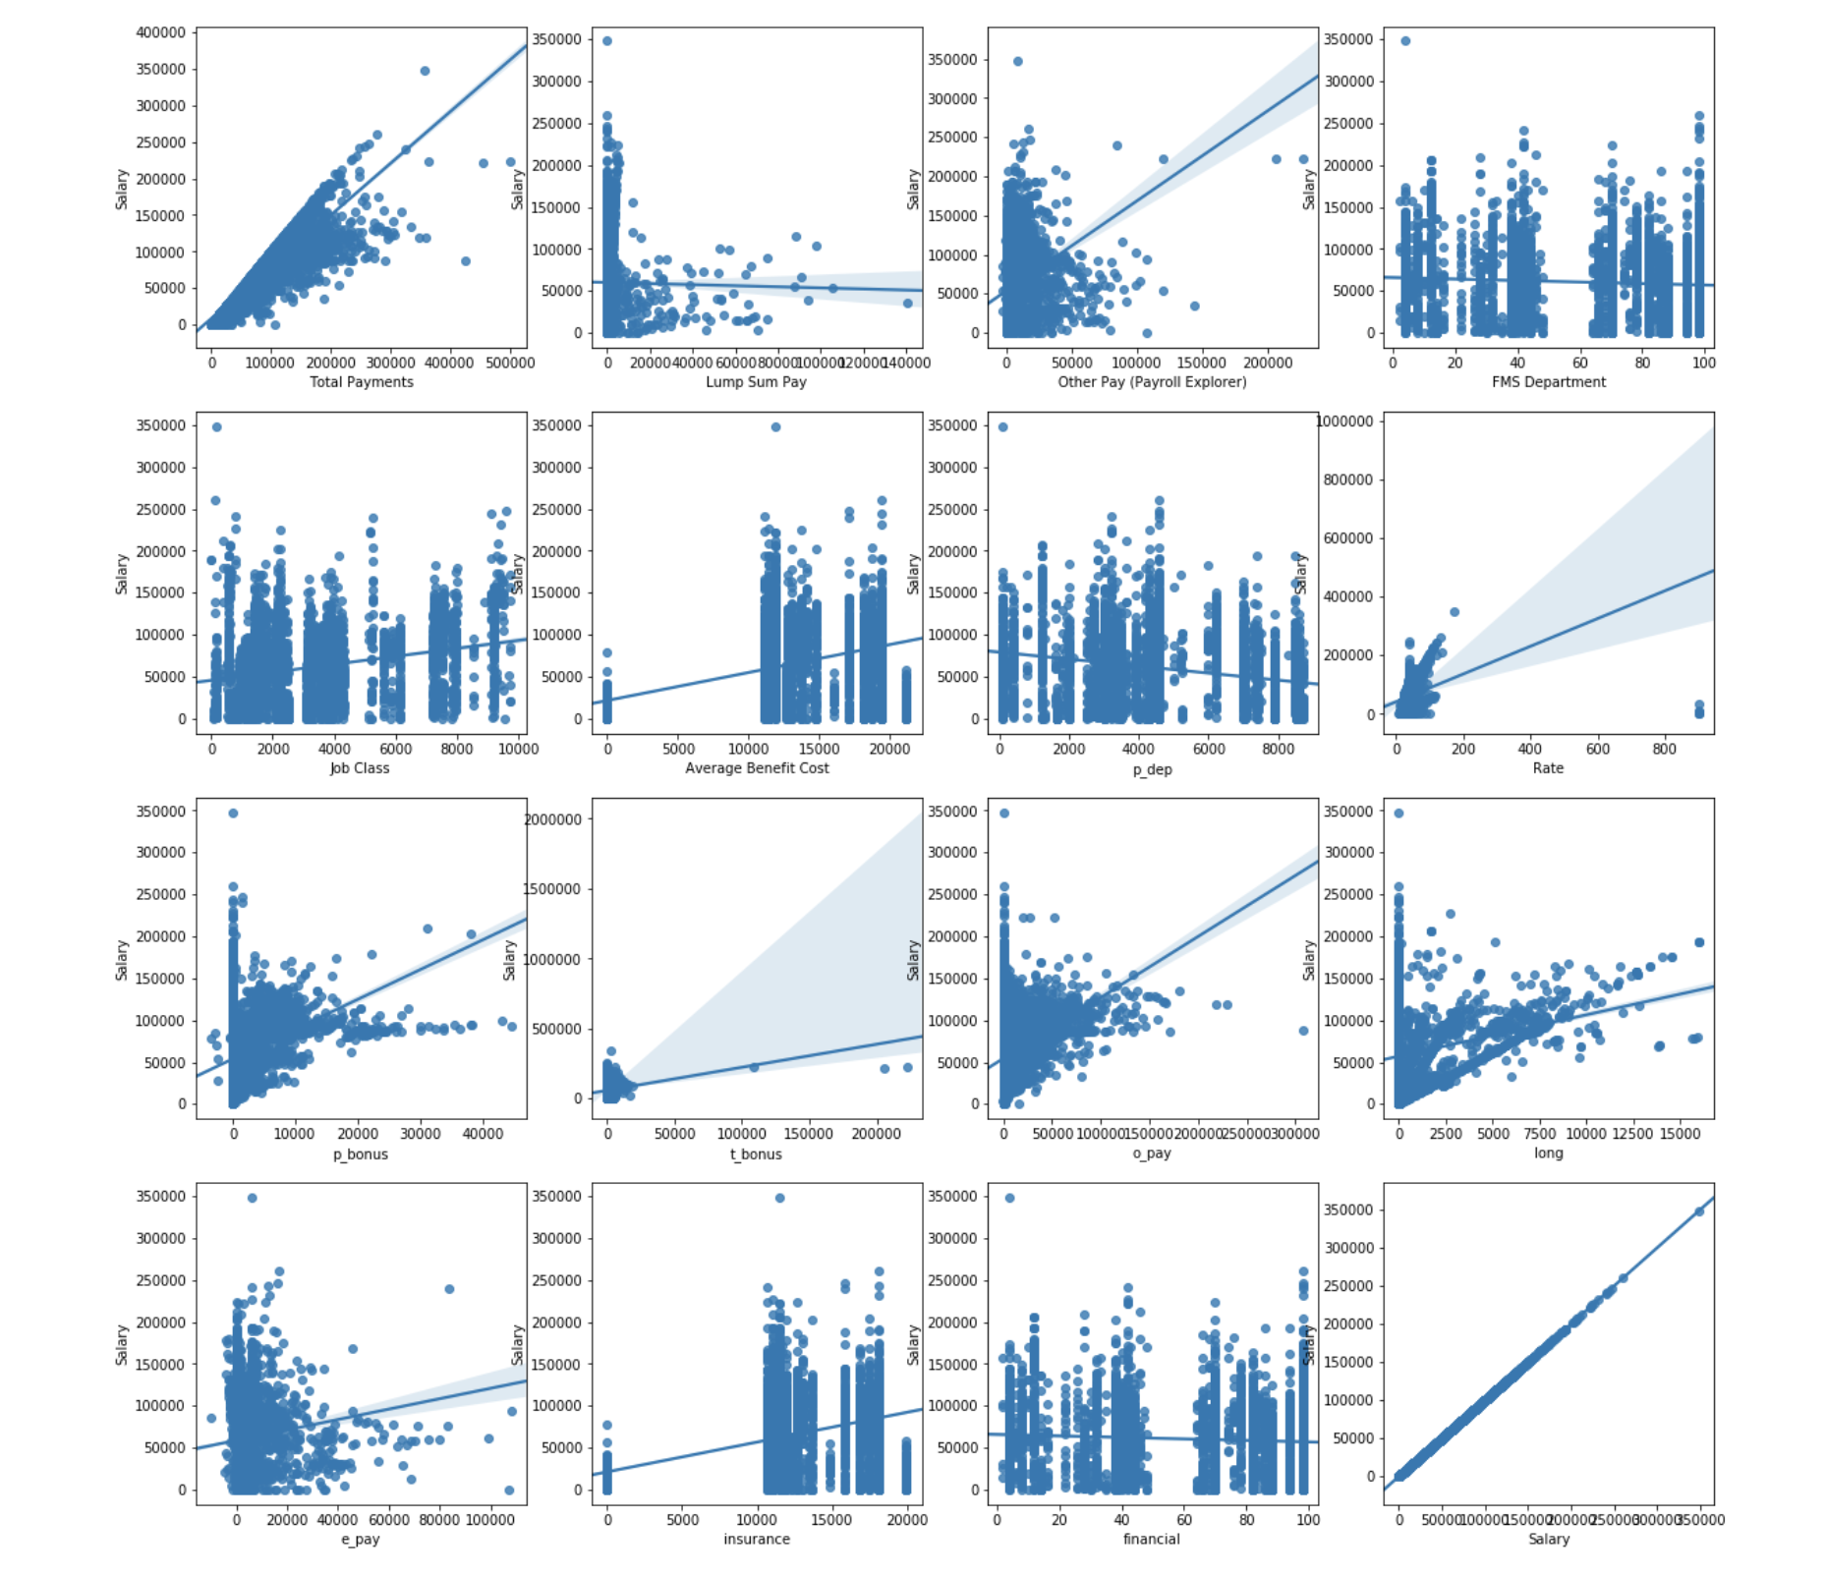
Scatterplots for numerical features after imputation

Slide 7
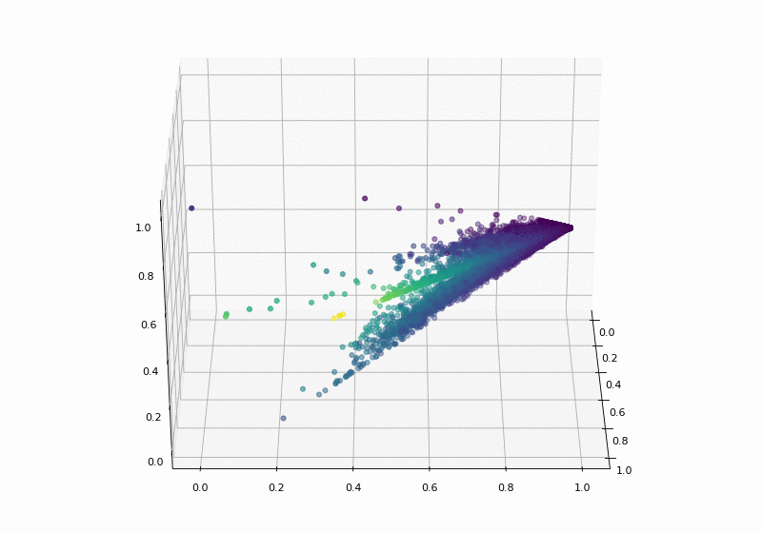
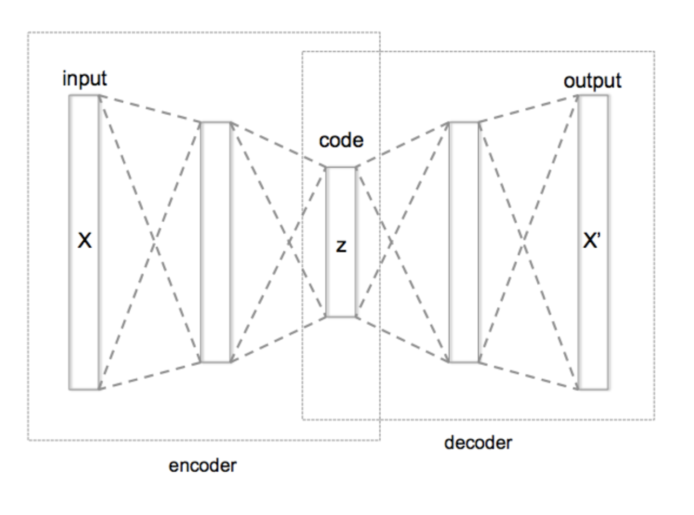
Data synthesis: Autoencoder!
Encoded the data into 2 dimensions
The color of the points reflects the value of Salary: the darker, the smaller salary; the brighter, the larger salary.
A obvious correlation between the data points and salary, although it can't be explained by regular linear relationship.
The data points all locate on one plane, which indicates 2 dimensions are enough to store the information of original data.
Notes:
We used TensorFlow to code autoencoder to synthesize new data as well as predict salary.
Our inputs are the data without Salary features, however, unlike the normal autoencoder, our outputs are the data with Salary features instead of sharing the same structure of input data. The idea is that we want the autoencoder neural network to figure out the relation between salary and the other features in the trainning process.
At first, we encoded the data into 3 dimensions as a dimention reduction and visulized these 3D data to figure out if there is correlation between the data and Salary. The visulization was stored at file 3D.gif. The color of the points reflects the value of Salary: the darkder color means smaller salary, the lighter color means larger salary. The GIF shows us there is a obvious correlation between the data points and salary, although it can't be explained by regular linear relationship. What's more, the data points all locate on one plane, which indicates 2 dimensions are enough to store the information of original data.

Slide 8
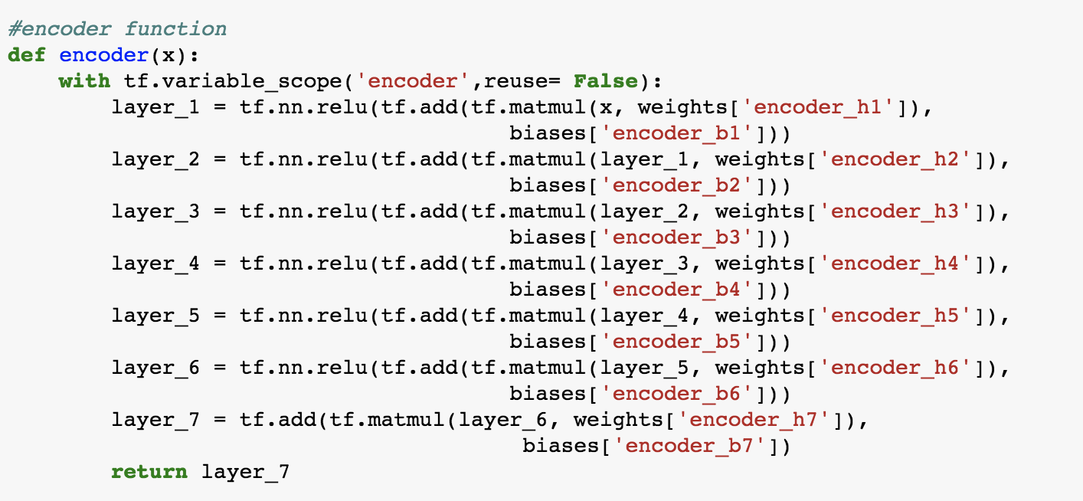
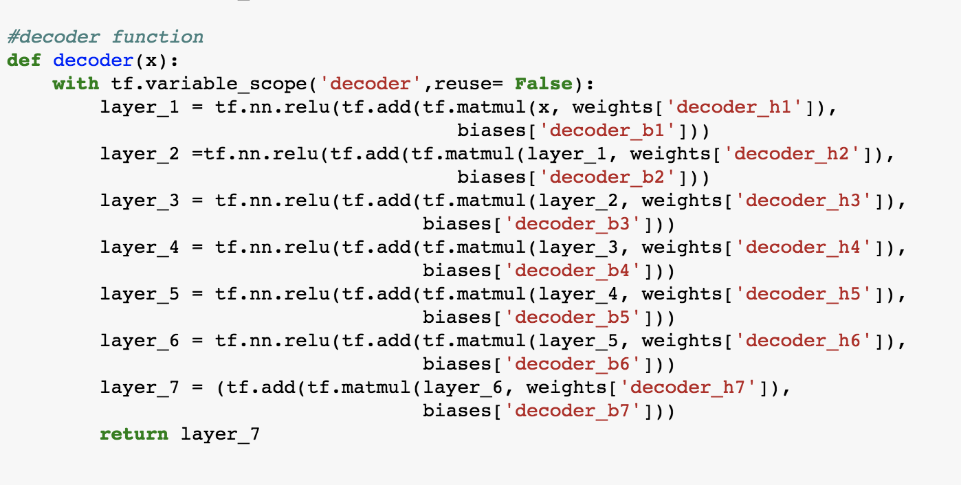
Structure of autoencoder
Encoder: 7 layers of Neural Network
Decoder: 7 layers of Neural Network

Slide 9
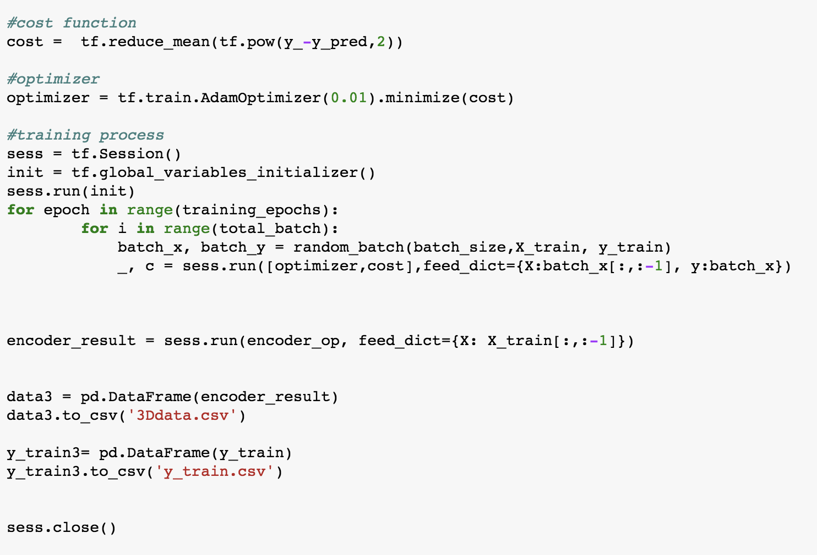
Use TensorFlow Code walkthrough
Notes:
When we training this model, the optimazation ofen trapped in a local minimum, whose visualization is a single line. So we had to train the model several times until it successfully arrived in global minimum.

Slide 10
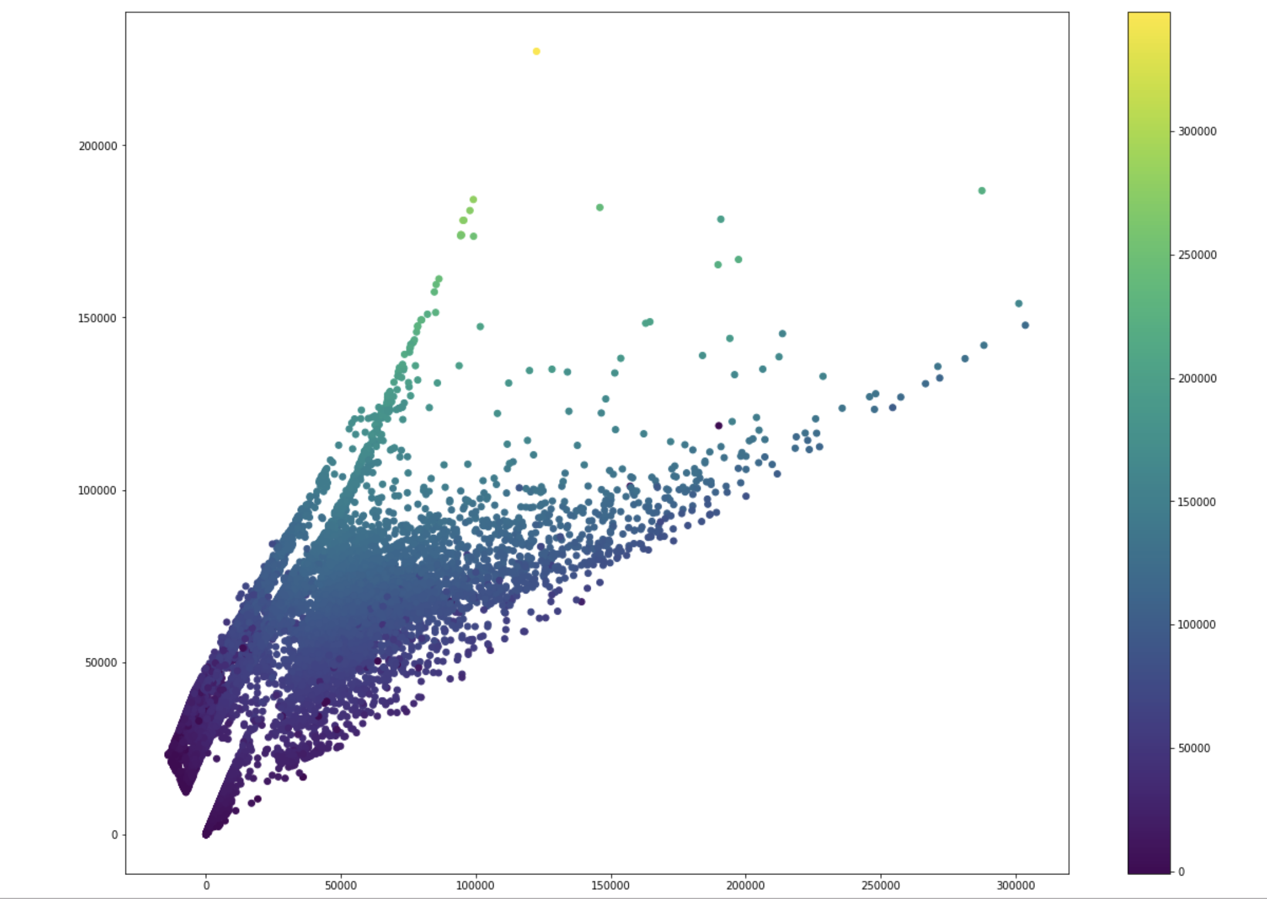
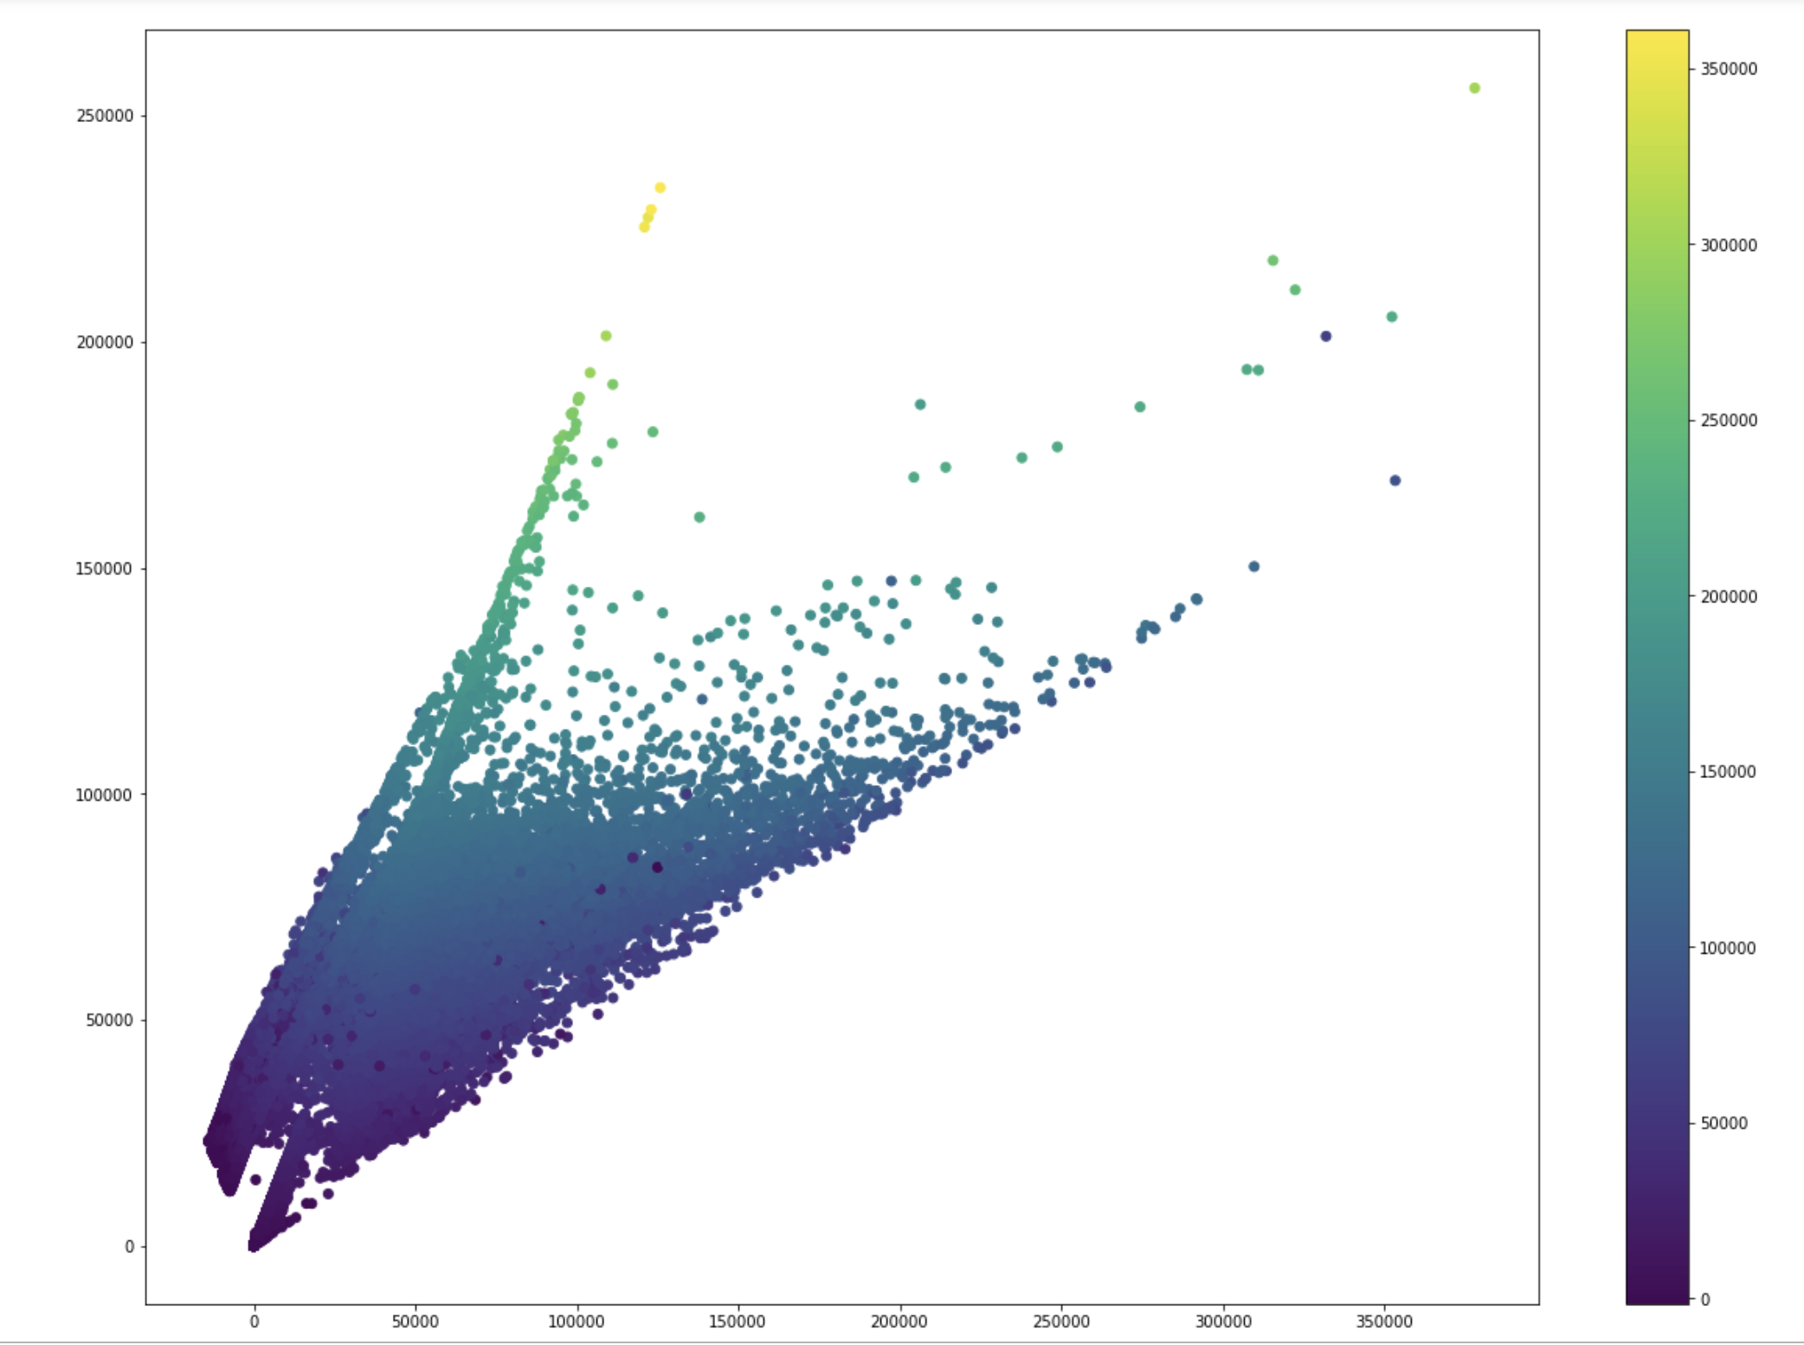
Evaluate the Autoencode performane
Test the encoder with testing set.
The color shows the value of True Salary of each point
Test the decoder with testing set
The color shows the value of the predictive value created by the autoencoder of each point.
Notes:
The 2 very similar pictures above indicate that the autocencoder successfully keeps the important information of the features except salary, which can also be used to predict salary. Therefore, we sure the synthesis data will remain the same (or similar) relationship with salary.

Slide 11
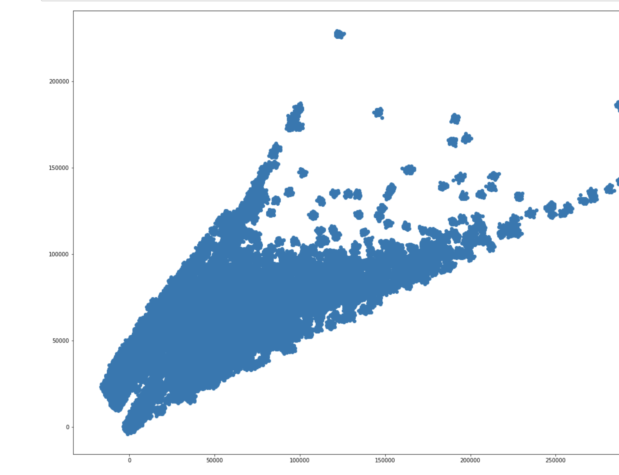
Use Decoder to synthesize new data
Although we can choose a random 2-dimensional point as the input of the decoder, we still hope our random sample has a similar distribution as the originial data.
We finally worked out a way to generate samples with the same distribution of given data.
Randomly pick up a point from the data
Choose 2 random values from a normal distribution and add the values to each dimension of the point respectively.
We assign a large variance of the normal distribution if we want a very different sample.

Slide 12
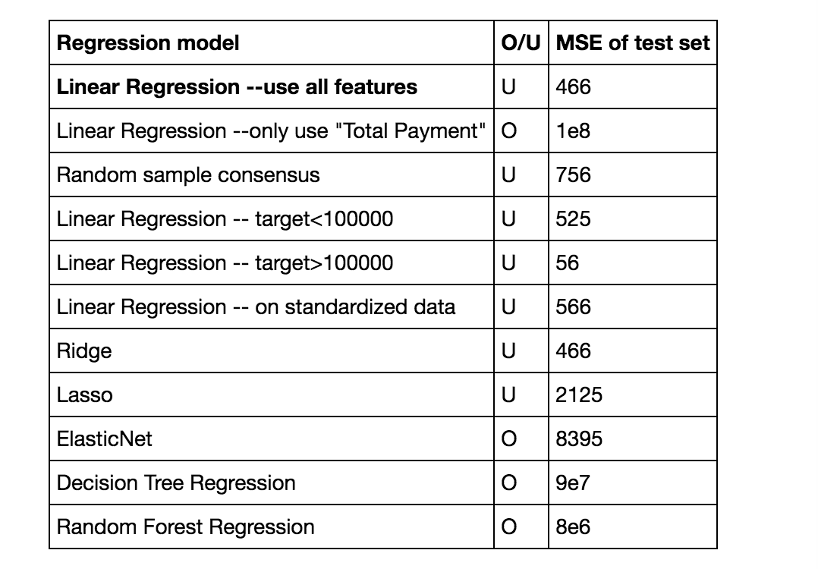
Model Building: Linear regression
Summary for all the models: O is Overfitting, U is Underfitting
Notes:
We found that Linear Regression has the best performace when we choose Mean Square Error as the performance index. Although more complex model (like Random Forest Regression) can solve the underfitting issue of Linear Regression, they are too complicated for the data (Overfitting) and have a large MSE on test set.

Slide 13
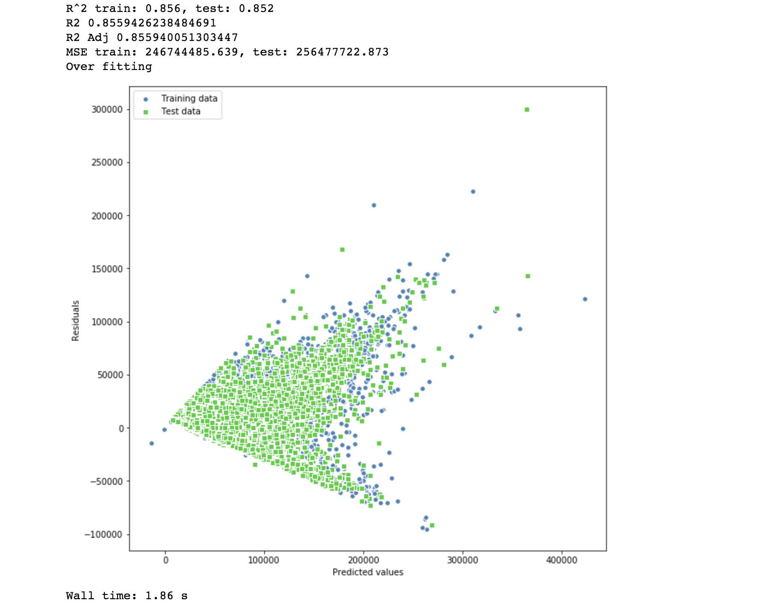
Linear Regression
One-hot-encoding for categorical features
Split train and validation into 0.7:0.3
Standardization into one scale
Build linear regression via Sklearn
Evaluate model performance:
Compute R^2 on train and test
R^2 Adj
MSE on train and test
Saved model into pickle

Slide 14
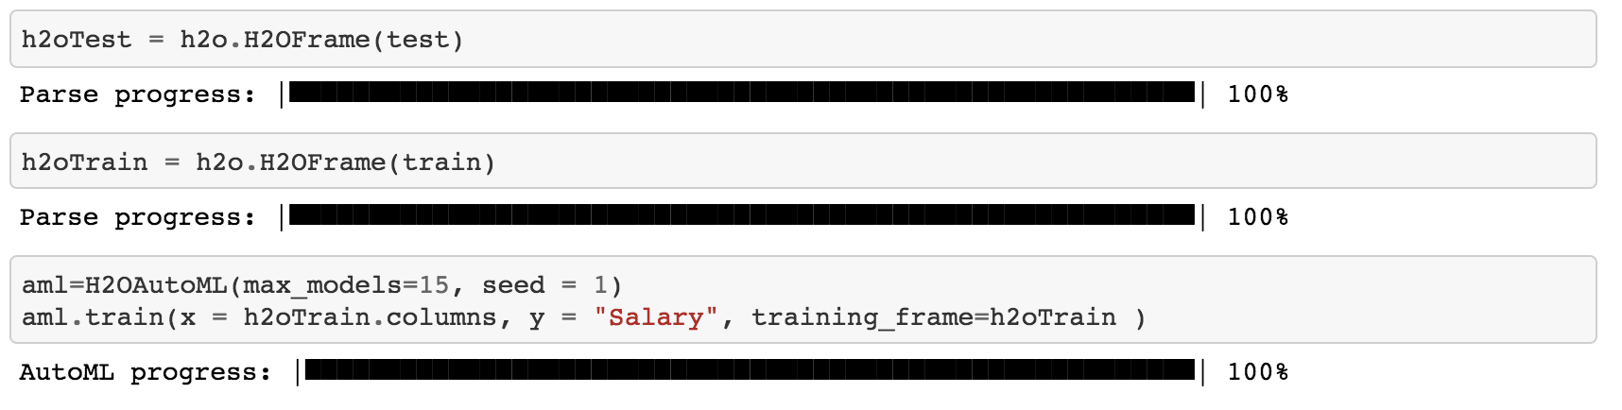
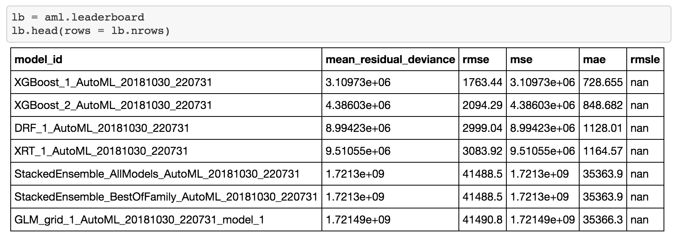
Model Building: XgBoost by H2O
The AutoML object includes a “leaderboard” of models that were trained in the process, including the 5-fold cross-validated model performance (by default).
The models are ranked by a default metric based on the problem type (the second column of the leaderboard). In binary classification problems, that metric is AUC, and in multiclass classification problems, the metric is mean per-class error. In regression problems, the default sort metric is deviance.
Notes:
H2O’s AutoML can be used for automating the machine learning workflow, which includes automatic training and tuning of many models within a user-specified time-limit.
by providing a simple wrapper function that performs a large number of modeling-related tasks that would typically require many lines of code

Slide 15
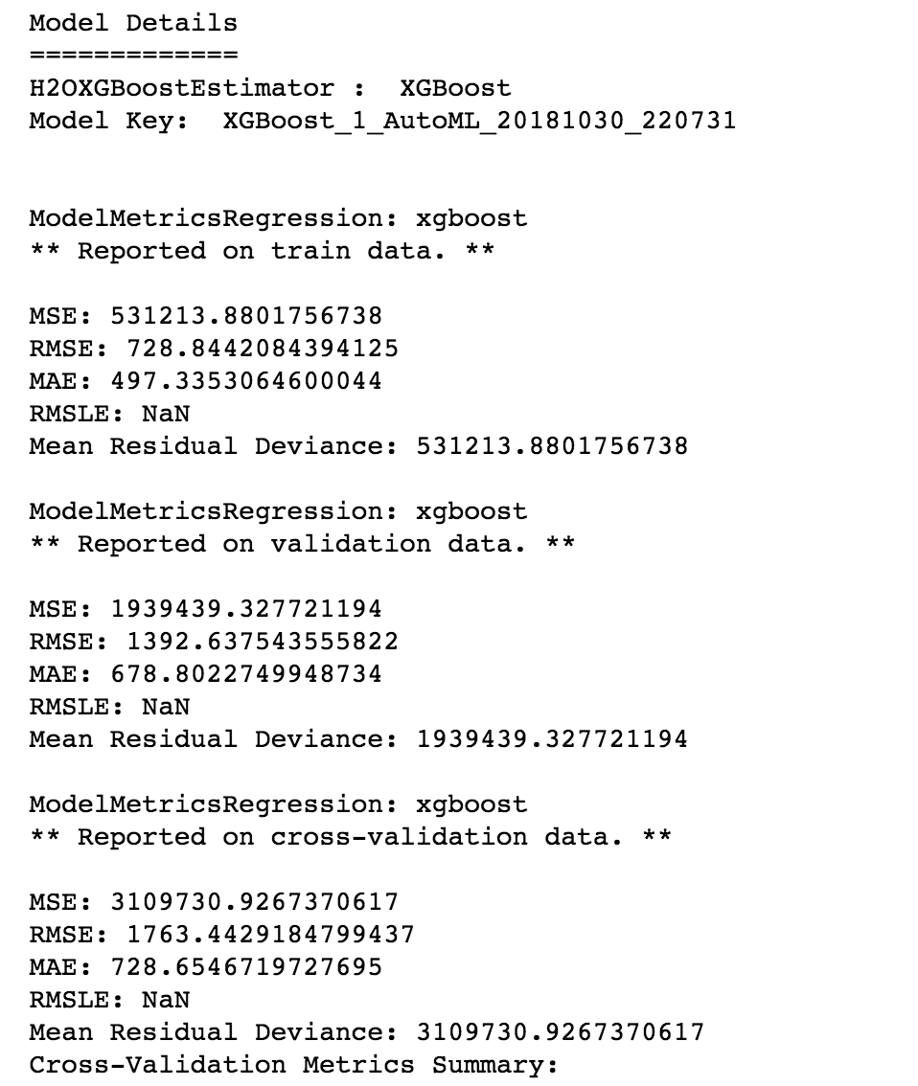
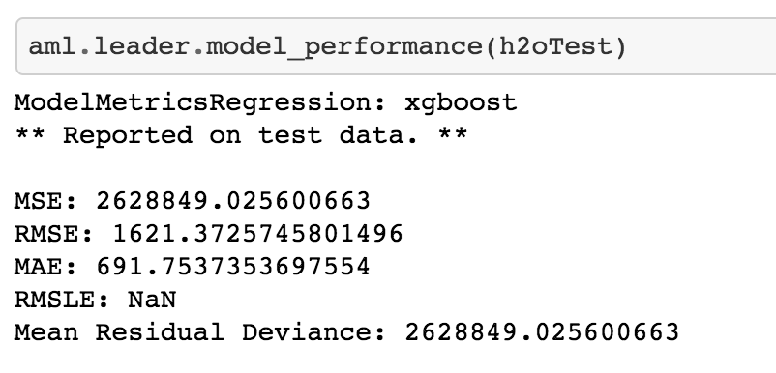
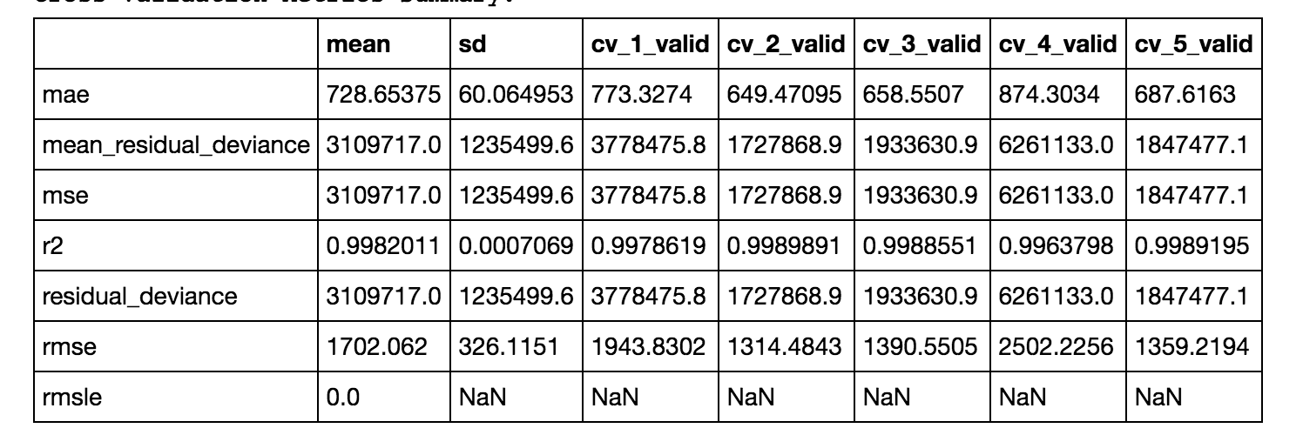
Output on training and testing

Slide 16
Quick Demo and Code Walkthrough
https://github.com/XC-Li/LMI-Data-Synthesis-Competition

